Slide 1

Software Development Life Cycle (SDLC)

Slide 2
SDLC
A framework that describes the activities performed at each Stage/Phase of a software development project.
Planning
Requirement Analysis
Designing
Implementation
Testing
Deployment / Maintains

Slide 3
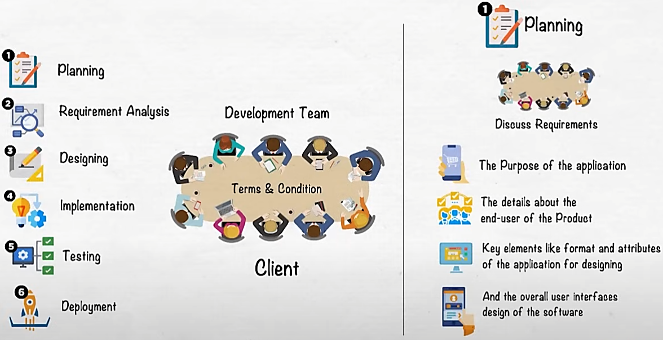
SDLC

Slide 4
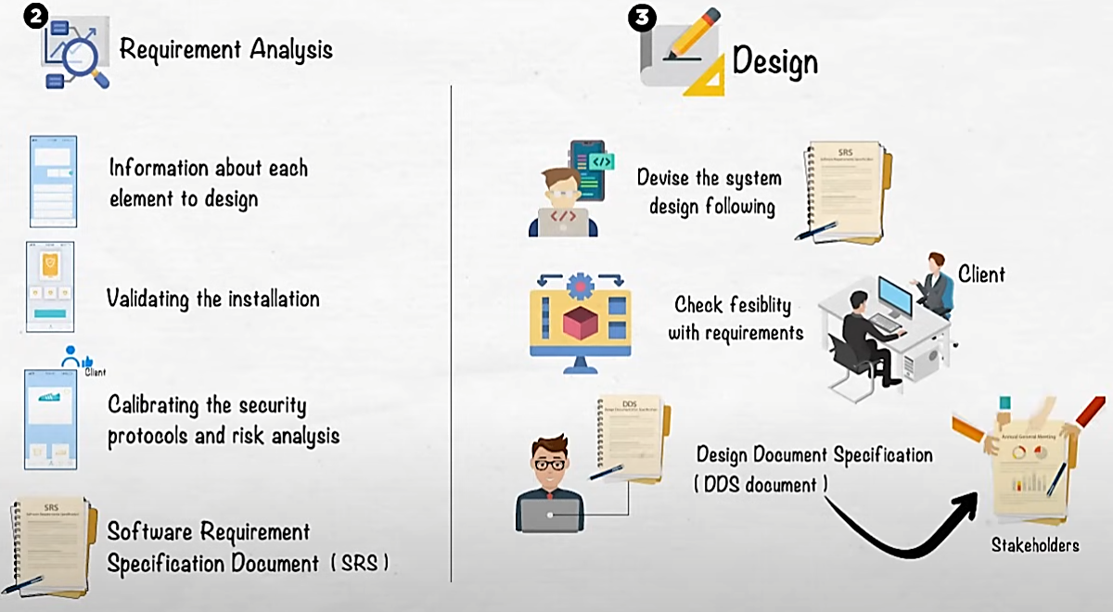
SDLC

Slide 5
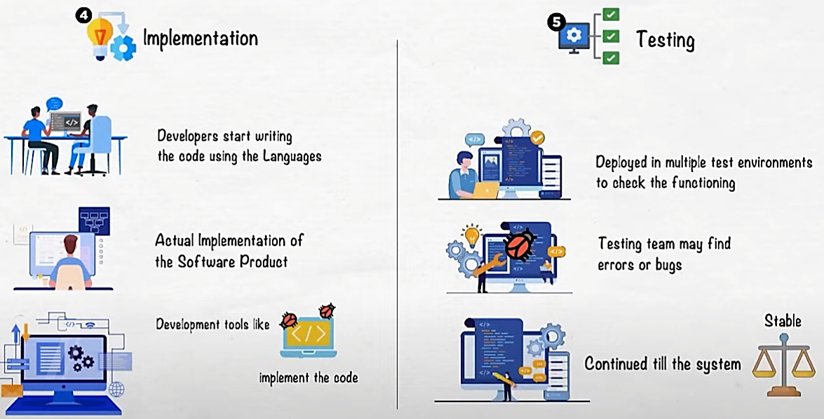
SDLC

Slide 6
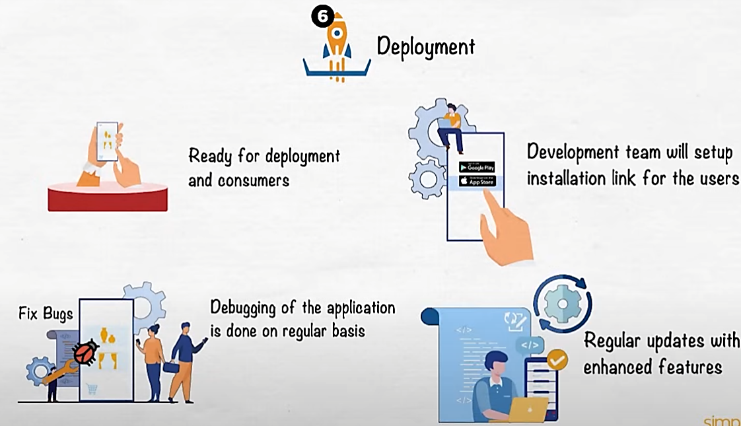
SDLC

Slide 7
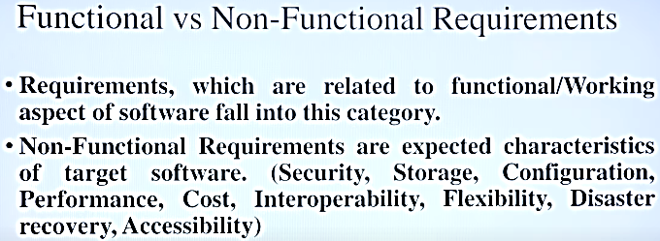
SDLC

Slide 8
SDLC Model
Software development models are various processes or methods that are chosen for project development depending on the objectives and goals of the project. Many development life cycle models have been developed to achieve various essential objectives. Models specify the various steps of the process and the order in which they are executed.
Table of Content
Top 8 Software Development Models
  1. Waterfall Model
  2. V-Model
  3. Incremental Model
  4. RAD Model
  5. Iterative Model
  6. Spiral Model
  7. Prototype model
  8. Agile Model

Slide 9
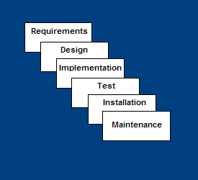
Waterfall Model (Base Model)
Feasibility Study– defines feasibility or practicality of the project.
Requirements – defines needed information, function, behavior, performance and interfaces.
Design – data structures, software architecture, interface representations, algorithmic details.
Implementation – source code, database, user documentation, testing.

Slide 10
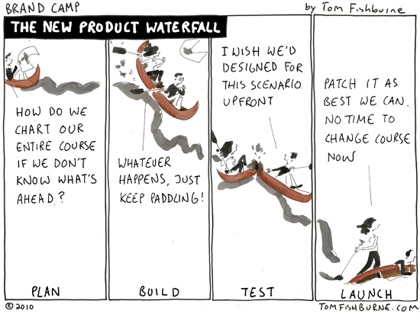

Slide 11
Waterfall Strengths (Small Projects)
Easy to understand, easy to use
Provides structure to inexperienced staff
Milestones are well understood
Sets requirements stability
Good for management control (plan, staff, track)
Works well when quality is more important than cost or schedule

Slide 12
Waterfall Deficiencies (No Feedback)
All requirements must be known upfront
Deliverables created for each phase are considered frozen – inhibits flexibility
Can give a false impression of progress
Does not reflect problem-solving nature of software development – iterations of phases
Integration is one big bang at the end
Little opportunity for customer to preview the system (until it may be too late)

Slide 13
When to use the Waterfall Model
Requirements are very well known
Product definition is stable
Technology is understood
New version of an existing product
Porting an existing product to a new platform.
  High risk for new systems because of specification and
  design problems.
  Low risk for well-understood developments using familiar technology.

Slide 14
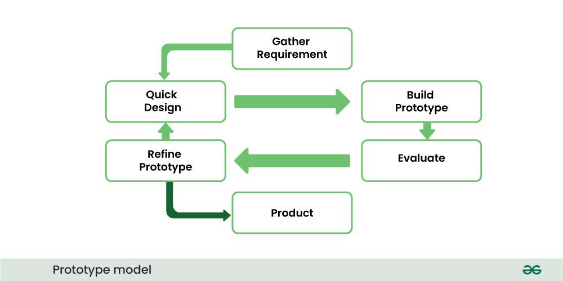
Prototyping: Basic Steps
Identify basic requirements
  Including input and output info
  Details (e.g., security) generally ignored
Develop initial prototype
  UI first
Review
  Customers/end –users review and give feedback
Revise and enhance the prototype & specs
  Negotiation about scope of contract may be necessary

Slide 15
Dimensions of prototyping
Horizontal prototype
A horizontal prototype shows a design from the user end (UI). It's used mostly in software design to help engineers understand the human interface of a project. Horizontal prototypes show menus, windows and screens on a computer to test how users interact with the product
  Broad view of entire system/sub-system
  Focus is on user interaction more than low-level system functionality (e.g. , database access)
  Useful for:
    Confirmation of UI requirements and system scope
    Demonstration version of the system to obtain buy-in from business/customers
    Develop initial estimates of development time, cost, effort

Slide 16
Dimensions of Prototyping
Vertical prototype
  A vertical prototype focuses on deep functionality in a narrow scope, often used to test a specific feature or key component of a product early in development, while a horizontal prototype focuses on broad functionality with less depth
  More complete elaboration of a single sub-system or function
  Useful for:
    Obtaining detailed requirements for a given function
    Refining database design
    Obtaining info on system interface needs
    Clarifying complex requirements by drilling down to actual system functionality

Slide 17
Types of prototyping
Throwaway /rapid/close-ended prototyping
  Creation of a model that will be discarded rather than becoming part of the final delivered software
  After preliminary requirements gathering, used to visually show the users what their requirements may look like when implemented
Focus is on quickly developing the model
  not on good programming practices
  Can Wizard of Oz things

Slide 18
Fidelity of Prototype
Low fidelity prototypes: These are low cost, rough and quick to build. They consist of sticky notes and sketches, which is great for high-level brainstorming and collaboration.
Medium fidelity prototypes: These are slightly more detailed, still rough but closer to the solution. They are often called wireframes.
High fidelity prototypes: These are much closer to final, very detailed and much more time-consuming. They almost represent the finished product.

Slide 19
Throwaway Prototyping steps
Throwaway prototyping means building initial ideas for different applications, interfaces, or functions, without necessarily having the intention of including them in the finished system. Rather, the idea is to gather feedback, prove concepts, or undertake other research tasks.
Write preliminary requirements
Design the prototype
User experiences/uses the prototype, specifies new requirements
Repeat if necessary
Write the final requirements
Develop the real products

Slide 20
Evolutionary Prototyping
Software development approach where a basic version of a system is created and then iteratively refined through user feedback and testing, leading to a final, functional product.
A breadboard prototyping
Goal is to build a very robust prototype in a structured manner and constantly refine it
The evolutionary prototype forms the heart of the new system and is added to and refined
Allow the development team to add features or make changes that were not conceived in the initial requirements

Slide 21
Evolutionary Prototyping Model
Developers build a prototype during the requirements phase
Prototype is evaluated by end users
Users give corrective feedback
Developers further refine the prototype
When the user is satisfied, the prototype code is brought up to the standards needed for a final product.

Slide 22
Evolutionary Prototyping Steps
A preliminary project plan is developed
An partial high-level paper model is created
The model is source for a partial requirements specification
A prototype is built with basic and critical attributes
The designer builds
  the database
  user interface
  algorithmic functions
The designer demonstrates the prototype, the user evaluates for problems and suggests improvements.
This loop continues until the user is satisfied

Slide 23
Incremental prototyping
Final product built as separate prototypes
At the end, the prototypes are merged into a final design

Slide 24
Extreme Prototyping
Often used for web applications
Development broken down into 3 phases, each based on the preceding 1
  Static prototype consisting of HTML pages
  Screen are programmed and fully functional using a simulated services layer
    Fully functional UI is developed with little regard to the services, other than their contract
  Services are implemented

Slide 25
Prototyping advantages
Reduced time and cost
  Can improve the quality of requirements and specifications provided to developers
    Early determination of what the user really wants can result in faster and less expensive software
Improved/increased user involvement
  User can see and interact with the prototype, allowing them to provide better/more complete feedback and specs
  Misunderstandings/miscommunications revealed
  Final product more likely to satisfy their desired look/feel/performance

Slide 26
Disadvantages of prototyping 1
Insufficient analysis
  Focus on limited prototype can distract developers from analyzing complete project
  May overlook better solutions
  Conversion of limited prototypes into poorly engineered final projects that are hard to maintain
  Limited functionality may not scale well if used as the basis of a final deliverable
    May not be noticed if developers too focused on building prototype as a model
  It spend a great deal of time/effort to produce

Slide 27
Iterative Model - Design
The iterative model is a software development approach that breaks down projects into smaller, manageable chunks called iterations, each involving planning, analysis, design, development, testing, and deployment, with each iteration building upon the previous one to refine and improve the product
The basic idea behind this method is to develop a system through repeated cycles (iterative) and in smaller portions at a time (incremental).

Slide 28
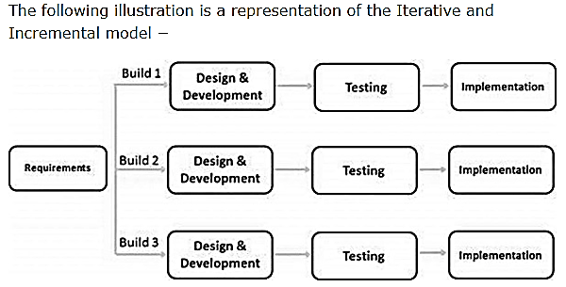

Slide 29
Spiral Model
The spiral model combines the idea of iterative (Repetition)development with the systematic, controlled aspects of the waterfall model.
This Spiral model is a combination of iterative development process model and sequential linear development model i.e. the waterfall model with a very high emphasis on risk analysis.
It allows incremental releases of the product or incremental refinement through each iteration around the spiral.

Slide 30
Spiral Model - Design
The spiral model has four phases. A software project repeatedly passes through these phases in iterations called Spirals.
Identification
Design
Construct or build
Evaluation and Risk Analysis

Slide 31
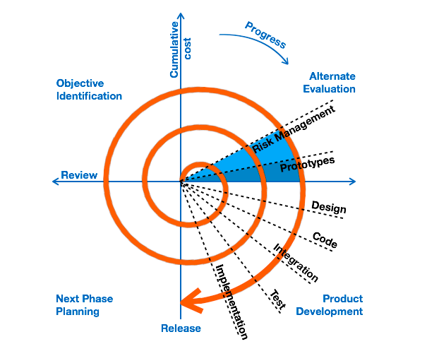
Spiral SDLC Model

Slide 32
Agile SDLC’s
Agile SDLC model is a combination of iterative and incremental process models with focus on process adaptability and customer satisfaction by rapid delivery of working software product. Agile Methods break the product into small incremental builds. These builds are provided in iterations. Each iteration typically lasts from about one to three weeks. Every iteration involves cross functional teams working simultaneously on various areas like −
Planning
Requirements Analysis
Design
Coding
Unit Testing and
Acceptance Testing.
The agile model refers to the iterative approach to delivering a software product. This means that instead of delivering a large project only when all parts are complete, a team breaks down a large project into smaller parts, and delivers these completed smaller parts in regular cycles.

Slide 33
Some Agile Methods
Rapid Application Development (RAD)
Incremental SDLC
Scrum
Extreme Programming (XP)
Adaptive Software Development (ASD)
Feature Driven Development (FDD)
Crystal Clear
Dynamic Software Development Method (DSDM)
Rational Unify Process (RUP)

Slide 34
What is Agile?
Agile model believes that every project needs to be handled differently and the existing methods need to be tailored to best suit the project requirements. In Agile, the tasks are divided to time boxes (small time frames) to deliver specific features for a release.
Iterative approach is taken and working software build is delivered after each iteration. Each build is incremental in terms of features; the final build holds all the features required by the customer.

Slide 35
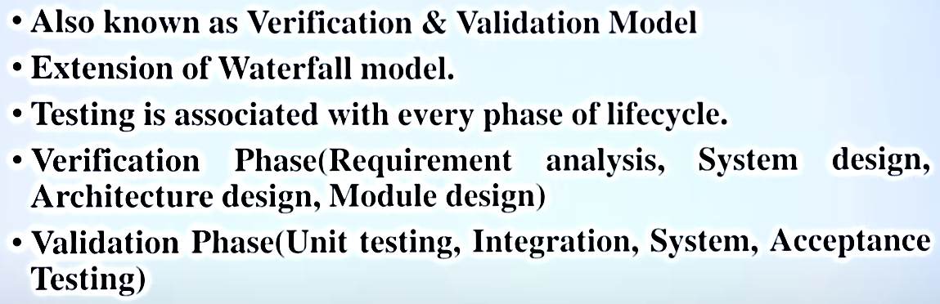
V-Shaped SDLC Model (Testing Model)
A variant of the Waterfall that emphasizes the verification and validation of the product.
Testing of the product is planned in parallel with a corresponding phase of development

Slide 36
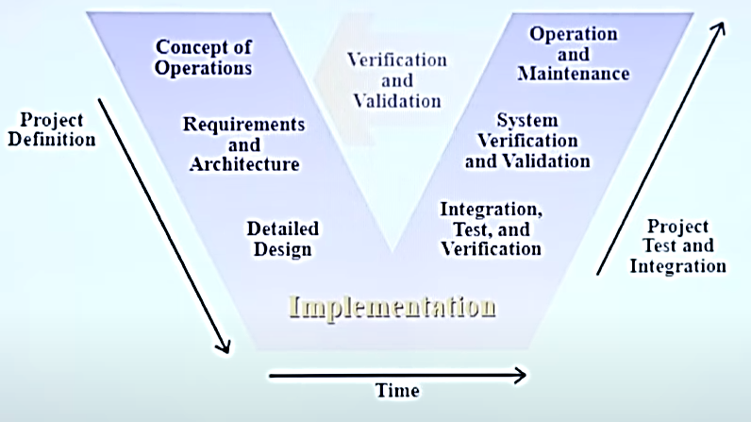
V-Shaped SDLC Model (Testing Model)

Slide 37
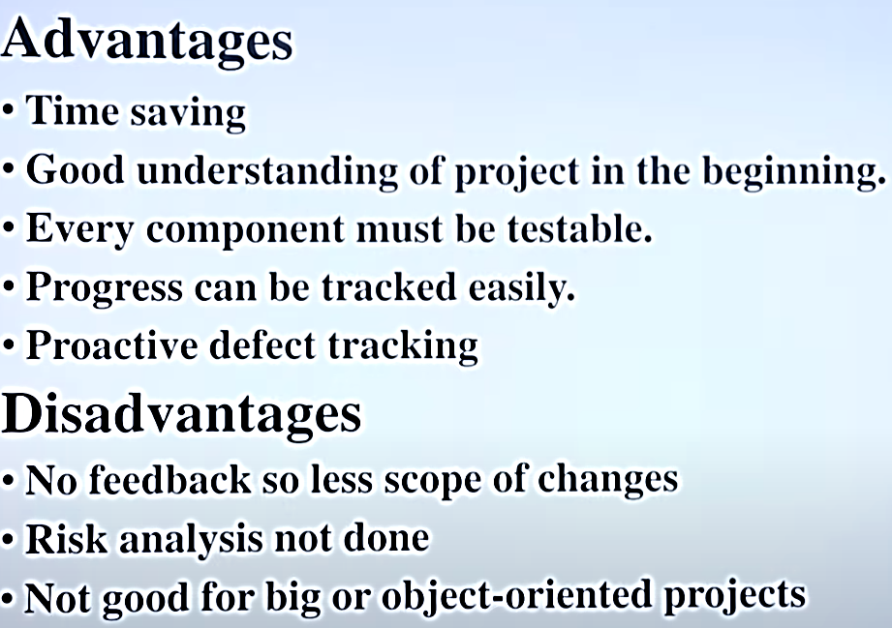
V-Shaped SDLC Model (Testing Model)

Slide 38
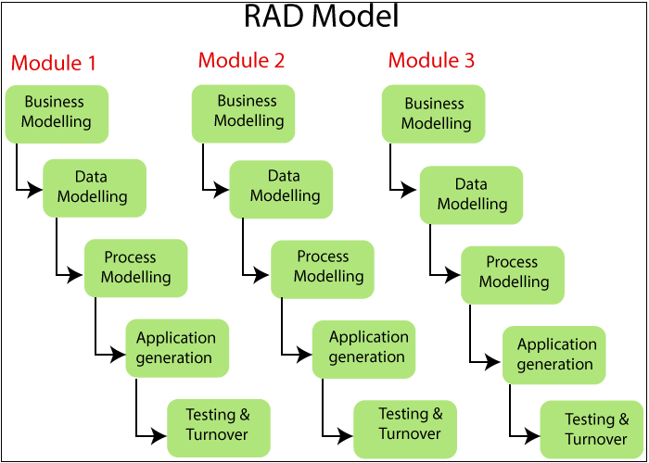
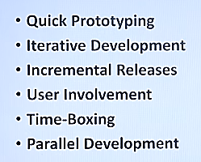
Rapid Application Model (RAD)
The RAD (Rapid Application Development) model is a software development methodology that prioritizes rapid prototyping and quick feedback over extensive planning, focusing on iterative and incremental development to deliver working models to the customer quickly.

